Slide 1

PowerShell介绍

Slide 2
资源
代码&PPT：
https://github.com/epmpub/learning-powershell

Slide 3


自我介绍
{
姓名：Andy Hu
位置：广州
职业：软件设计
博客: https://www.write-host.com
}
我的微信和公众号

Slide 4

What’s PowerShell
Unlike most shells, which accept and return text, Windows PowerShell is built on top of the .NET Framework common language runtime (CLR) and the .NET Framework, and accepts and returns .NET Framework objects. This fundamental change in the environment brings entirely new tools and methods to the management and configuration of Windows.
Windows PowerShell introduces the concept of a cmdlet (pronounced "command-let"), a simple, single-function command-line tool built into the shell. You can use each cmdlet separately, but their power is realized when you use these simple tools in combination to perform complex tasks. Windows PowerShell includes more than one hundred basic core cmdlets, and you can write your own cmdlets and share them with other users.
Like many shells, Windows PowerShell gives you access to the file system on the computer. In addition, Windows PowerShell providers enable you to access other data stores, such as the registry and the digital signature certificate stores, as easily as you access the file system.
Base on .NET Framework
Object
Cmdlet
Independently or Combination
Process, File System, Register
Notes:
意味着可以调用所有的.NET资源
.NET封装了所有的Windows API
目前所有的windows都预先安装了.NET
不像Linux BASH一样使用文本接受、返回对象,PowerShell使用了对象，这样让脚本具备更好的组织能力和具备了更好阅读性。
你可以简单的当作一个命令来使用，也可以将命令组合在一起，完成复杂的任务.
可以操作进程，文件系统，注册表

Slide 5
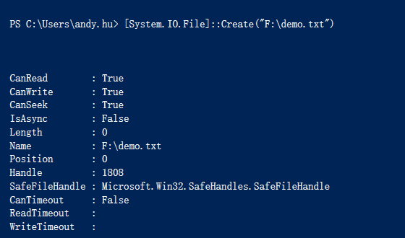

Invoke .NET Framework method
#Invoke .NET framework to create a file
[System.IO.File]::Create("F:\demo.txt")
#Delete file Invoke .NET framework
[System.IO.File]::Delete("F:\demo.txt")
Notes:
怎么样调用.NET提供的方法

Slide 6
Cmdlet
命令：
Get-Command
说明:
The Get-Command cmdlet gets all commands that are installed on the computer, including cmdlets, aliases, functions, workflows, filters, scripts, and applications.
Cmdlets
Aliases
Function
Scripts
Applications
Workflow
filter
动词
-verb
名词
-noun
类型
-commandtype
Notes:
快速把握整体cmdlet
先分类，再学习
动词 (-verb get)
名词 (-noun Disk,Process)
类型 (-commandtype alias)

Slide 7
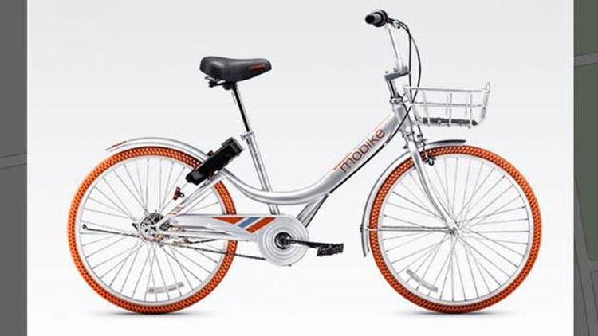
Objects
Parts
Parts
Properties
How to use
Methods
How to use
Front Wheel
Front Wheel
Pedal
Back Wheel
Back Wheel
Steer Left
Pedals
Pedals
Steer Right
Saddle
Saddle
Apply Front Brake
“An object is a collection of parts and how to use them”
Notes:
什么是Object，就是一堆包含一堆零件和如何使用他的指南
计算机的object 表现为封转了属性和方法的集合

Slide 8

Objects （对象）
Parts
Properties
How to use
Methods
DisplayName
Stop()
Windows
Service
Start()
Status
RequiredServices
Pause()
gps notepad | Get-Member -MemberType Properties
gps notepad | Get-Member -MemberType Method
Notes:
Object
Properties - 静态
Method – 动态
查找一个对象的属性和方法；

Slide 9

命令的组合
Common Windows PowerShell Parser
Get-Process Cmdlet
Where
Cmdlet
Sort Cmdlet
Format Cmdlet
Windows PowerShell Pipeline Processor
Get-Process | where {$_.ProcessName -eq "chrome"} | sort -Property CPU | Format-Table -Property ID,SI
Notes:
PipeLine 管道 ，通过管道可以将几个简单的Cmdlet 组合成强大的命令

Slide 10
命令探索
Command | Function
Get-Command | Get information about anything that can be invoked
Get-Member | Show what can be done with an object
Get-Help | Help about PowerShell commands and topics
Notes:
Find out the world.

Slide 11




一些资源

Slide 12
Questions?

